Slide 1
Flow Control chap-7

Slide 2
Data Link Control Protocols
Physical layer concentrates on sending signals over transmission link
More control and management is needed to send data over data communications link
Frame synchronization: start and end of each frame
Flow control: ensure sender does not send too fast for receiver
Error control: correct bit errors introduced by transmission system
Addressing: must specify identity of two stations communicating
Control and data: receiver must distinguish between control and data information
Link management: setup and maintain the link
We will focus on Flow Control and Error Control

Slide 3
Flow Control
Flow control aims to ensure sending entity does not overwhelm receiving entity.
If sender sends too fast for receiver, then buffer may overflow
Result of buffer overflow: data is lost, possibly need to retransmit, which reduces performance
Flow control tries to prevent buffer overflow
Assume no errors but varying delays

Slide 4
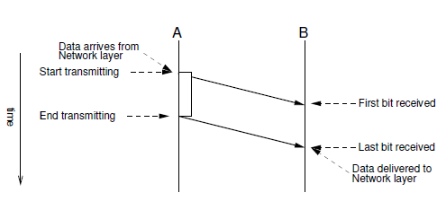
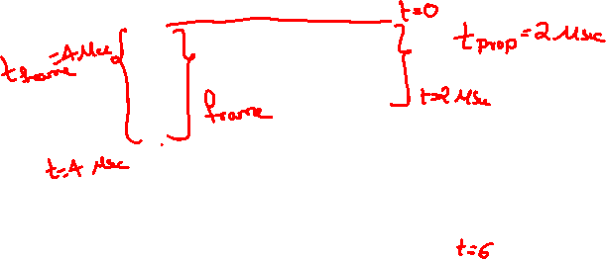

Slide 5
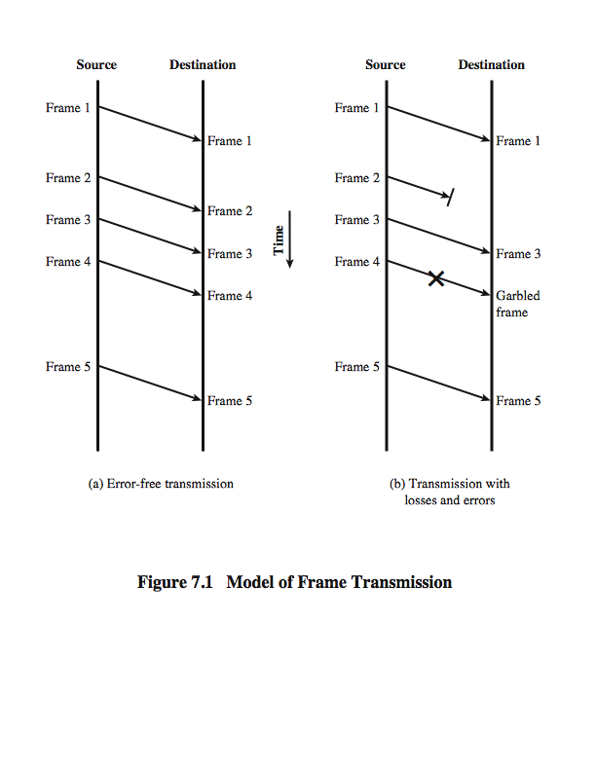
Model of Frame Transmission

Slide 8
Stop-and-Wait Flow Control
Frame Types
DATA: contains information to be sent
ACKnowledgement: acknowledges receipt of data
Rules
Source transmits a DATA frame
Source waits for ACK frame before sending next DATA frame
Destination receives DATA frame and replies with an ACK if ready for more data
Destination can stop flow of data by not sending ACK

Slide 9
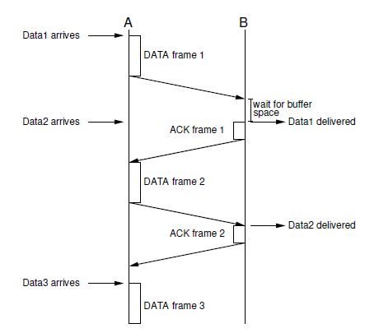

Stop-and-Wait Flow Control

Slide 10
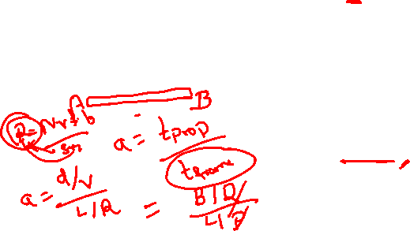
Stop and Wait Link Utilization
Propagation delay is the time it takes for a bit to travel from sender to receiver, depends on
transmission media and
the distance between sender and receiver
B = R x (d/V)
B: length of the link in bits
R: data rate of the link, in bps
d: length or distance of the link in meters
V: velocity of propagation, in m/s
a = B/L
a: the propagation delay (with frame tx time = 1)
L: the number of bits in the frame
Propagation delay=d/V
Round-Trip Time = 2 × propagation delay

Slide 11
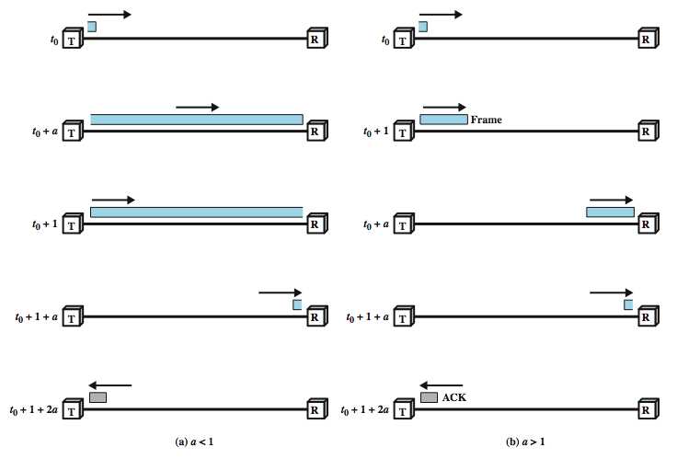
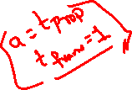
Stop and Wait Link Utilization

Slide 12


Slide 13
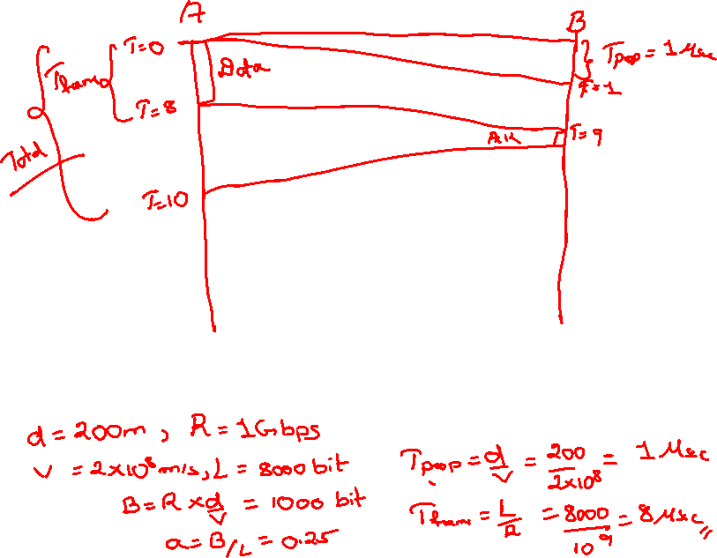

Slide 14
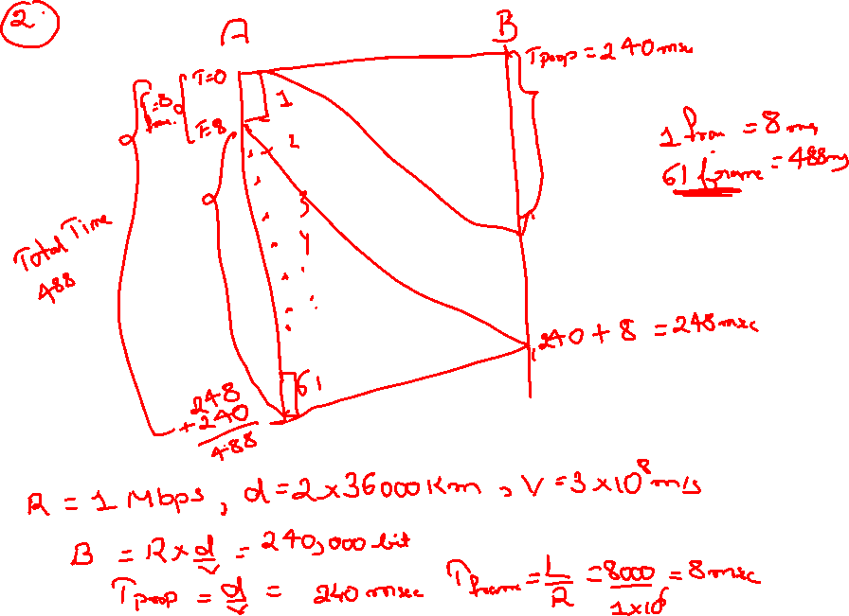

Slide 15
What Size Frames To Use?
Protocols often limit size of packets (frames), i.e. maximum number of bytes of data or payload
Large frames minimize header overheads
Small frames:
Allow more data to be sent when receive buffers are limited
Introduce small overhead if a retransmission is required
Allow fair sharing amongst multiple users
Optimal packet size depends on overheads, and desired throughput and delay performance

Slide 16


Efficiency of Stop-and-Wait Flow Control
Efficiency n, for stop-and-wait flow control:
where: Data, Hdr, Ack are transmission times of original data in DATA frame, header in DATA frame and ACK frame respectively; Prop is link propagation time

Slide 17
Sliding-Window Flow Control
Stop-and-wait allows only 1 frame to be in transit at a time
Sliding-window flow control allows multiple frames to be in transit at a time
Sequence Numbers
Each frame header contains k-bit sequence number (wraps back to 0 after 2^{k} -1)
Keep track of frames sent and acknowledged

Slide 18
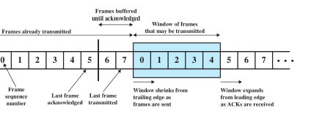
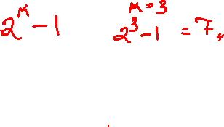
Sliding-Window Flow Control
The Sender
Sender is allowed to send up to W frames without receiving ACK
Sender records:
Last frame acknowledged
Last frame transmitted
Current window size

Slide 19
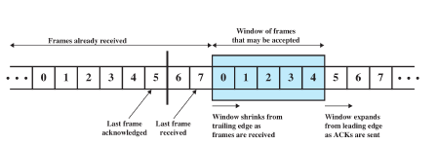
Sliding-Window Flow Control
The Receiver
Receiver has buffer space for W frames
Receiver records:
Last frame acknowledged
Last frame received
Current window size
Receiver sends an ACK (or Receiver Ready, RR) frame
ACK contains sequence number of next expected DATAframe

Slide 20
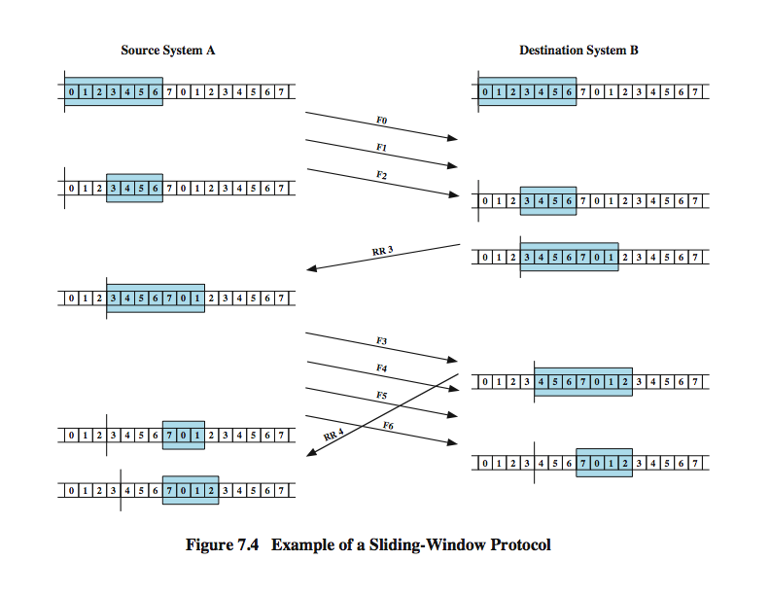
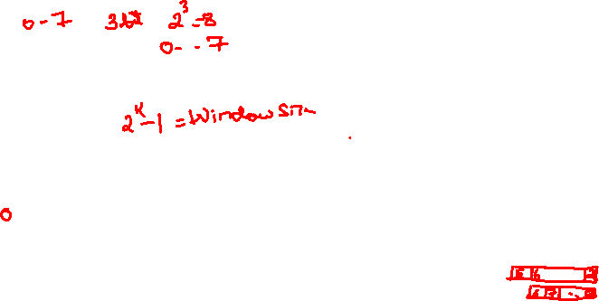
Example

Slide 21
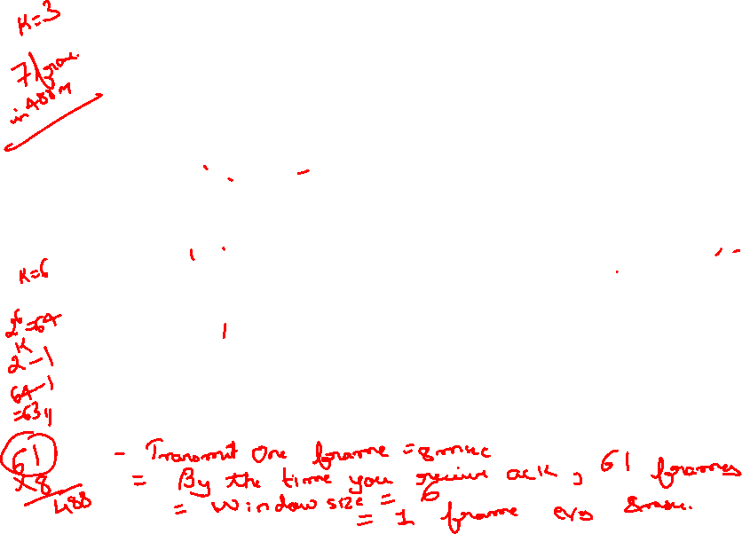

Slide 22
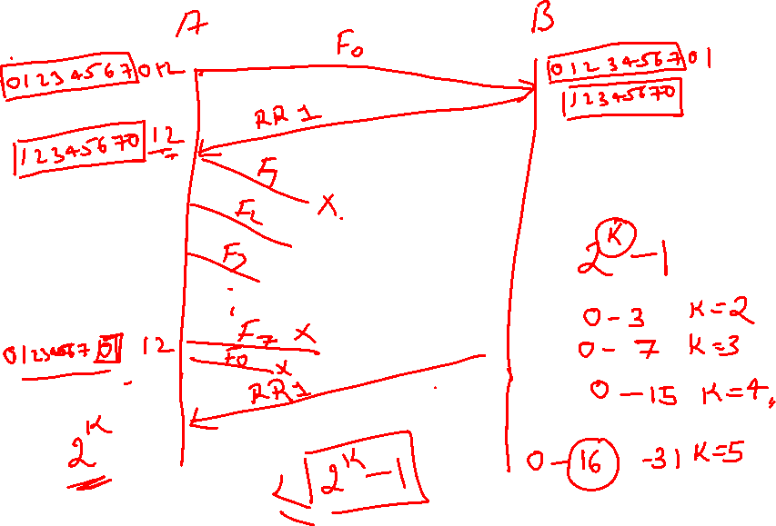

Slide 23
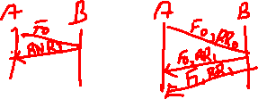

Additional Features of Sliding Window
Receive Not Ready frame: acknowledges received frames but does not allow any more data
Piggybacking: DATA frame header contains sequence number of DATA and sequence number of ACK (acknowledgement number)
If no DATA to send, normal ACK is transmitted
If no new ACK, previous ACK number is repeated in DATA frame

Slide 24
Example
A channel has a data rate of 4 kbps and a propagation delay of 20 ms. For what range of frame sizes does stop-and-wait give an efficiency of at least 50%?

Slide 25
Stop-and-Wait Flow Control
Station sends F1
1
Station sends an acknowledgment.
2
Station sends F2
3
Station sends an acknowledgment.
4
Station sends Fn
5
Station sends an acknowledgment.
6

Slide 26
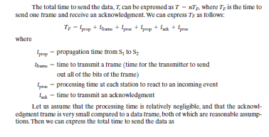
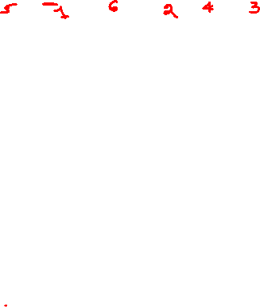

Slide 27



Slide 28



Slide 29
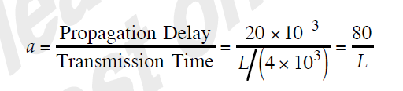
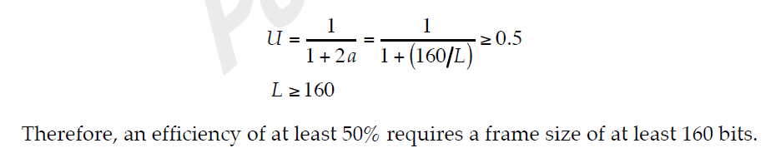

bgb[AT]tezu.ernet.in

Slide 30
Example
A sender sends a series of frame to the same destination using 5-bit sequence numbers. If the sequence number starts with 0, what is the sequence number of 101th frame?

Slide 31
A five-bit sequence number can create sequence numbers from 0 to 31
The sequence number in the Nth frame is (N mod 32)
101th frame has the sequence number (101 mod 32) or 5.

Slide 32
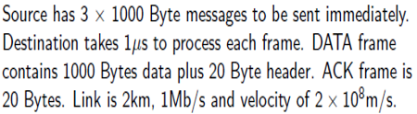
Calculate efficiency

Slide 33
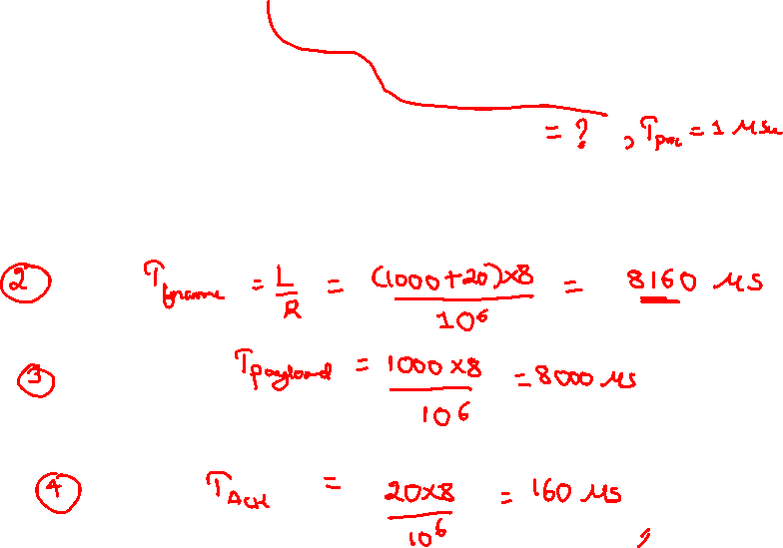
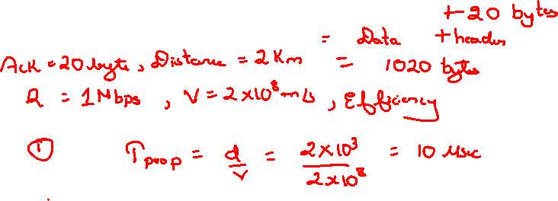

Slide 34
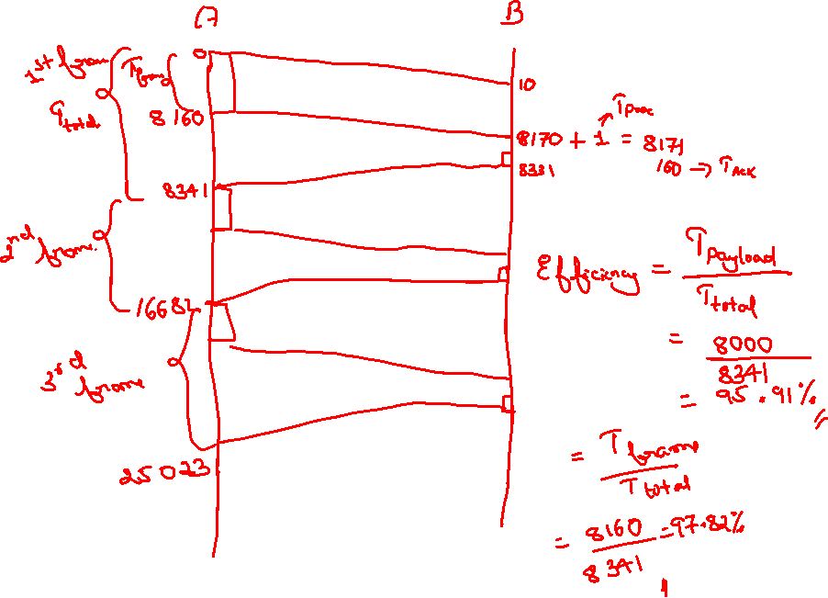

Slide 35


Slide 36
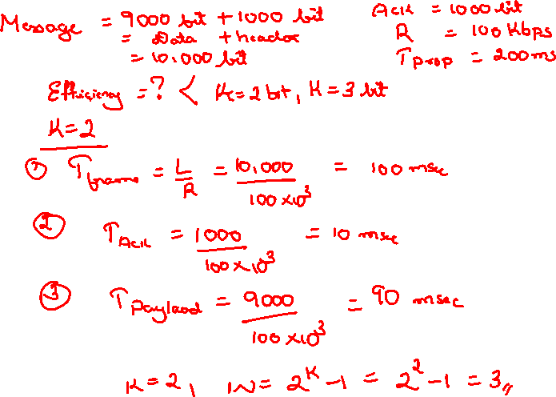

Slide 37
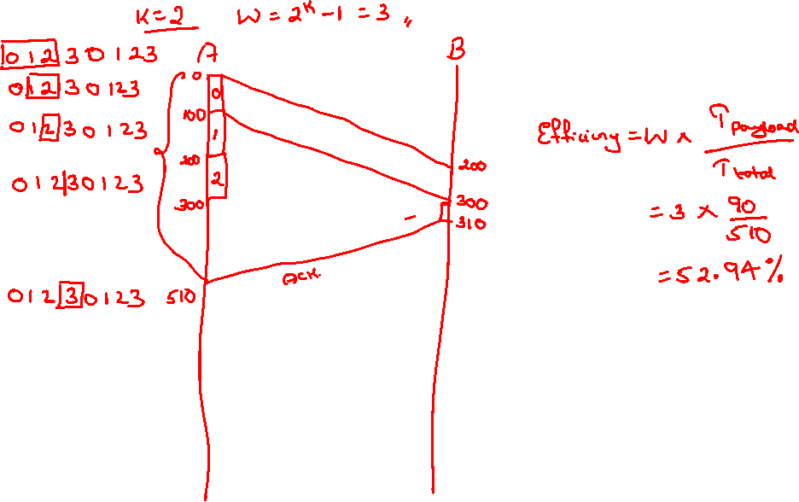

Slide 38
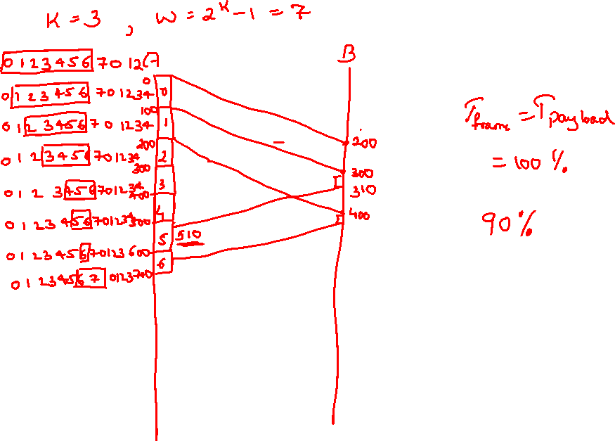

Slide 39
Utilization
U=1 when W≥2a+1
U=W/2a+1 when W<2a+1

Slide 40
Example
Consider the use of 1000-bit frames on a 1-Mbps satellite channel with a 270-ms delay. What is the maximum link utilization for
Stop-and-wait flow control?
Continuous flow control with a window size of 7?
Continuous flow control with a window size of 127?
Continuous flow control with a window size of 255?

Slide 41
L=10³, R=10⁶
a= propagation Time/(L/R)
a=270 ×10⁻³/(10³/ 10⁶) = 270
U = 1/(1 + 2a) = 1/541 = 0.002
U = W/(1 + 2a) = 7/541 = 0.013
U = 127/541 = 0.23
U = 255/541 = 0.47

Slide 42
Error Control
Need to detect and correct errors such as:
Lost frames: frame not received
Damaged frames: frame received with errors
Common techniques used:
Error detection and FEC
Positive acknowledgment: destination returns a positive ACK after successfully receiving error-free frames
Retransmission after timeout: source retransmits a frame that has not been ACKed after predetermined time
Negative acknowledgement and retransmission: destination returns negative ACK for frames in which an error is detected

Slide 43
Last 3 techniques are called automatic repeat request (ARQ). Three versions:
Stop-and-wait ARQ
Go-back-N ARQ
Selective-reject ARQ

Slide 44
Stop-and-Wait ARQ
Based on Stop-and-Wait flow control
Source transmits single frame, starts timer and maintains copy
If ACK received, stop timer and transmit next frame
If no ACK received before timer expires, retransmit copy of frame
Destination sends ACK if frame received (with no errors); if damaged frame, then discard frame
Frames have 1-bit sequence number (alternate between 0 and 1)
Used for destination to distinguish between duplicate DATA frames in case of damaged ACK
Stop-and-Wait ARQ is simple, but inefficient

Slide 45
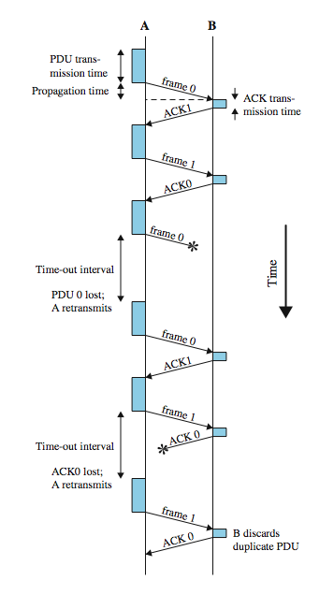

Slide 46
Example
A system uses the Stop-and-Wait ARQ Protocol. If each frame carries 1000 bits of data, how long does it take to send 1 million bits of data if the distance between the sender and receiver is 5000 Km and the propagation speed is 2 x 10⁸ m? Ignore transmission, waiting, and processing delays. We assume no data or control frame is lost or damaged.

Slide 47
Propagation delay=d/V
d=5000km=5 x 10⁶ m, V= 2 x 10⁸ m
Propagation delay=5 x 10⁶ / 2 x 10⁸ =25ms
Nr of frame=1000000/1000=1000
Time delay for one successful frame delivery is 50ms(Ignore transmission, waiting, and processing delays. We assume no data or control frame is lost or damaged)
For 1000 frame, time delay=1000x50ms=50s

